Slide 1


Slide 2
Agenda
Introduction
Database
Primary goals
Implementation and
Methods used
Conclusion

Slide 3
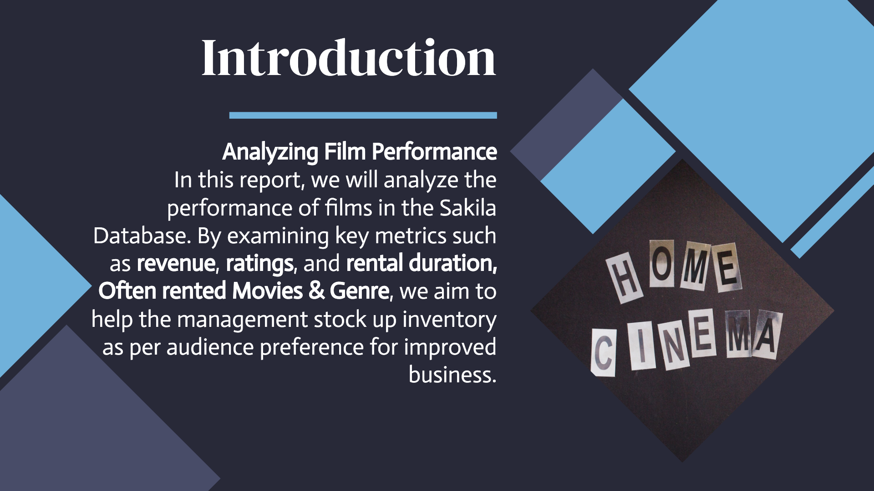

Slide 4
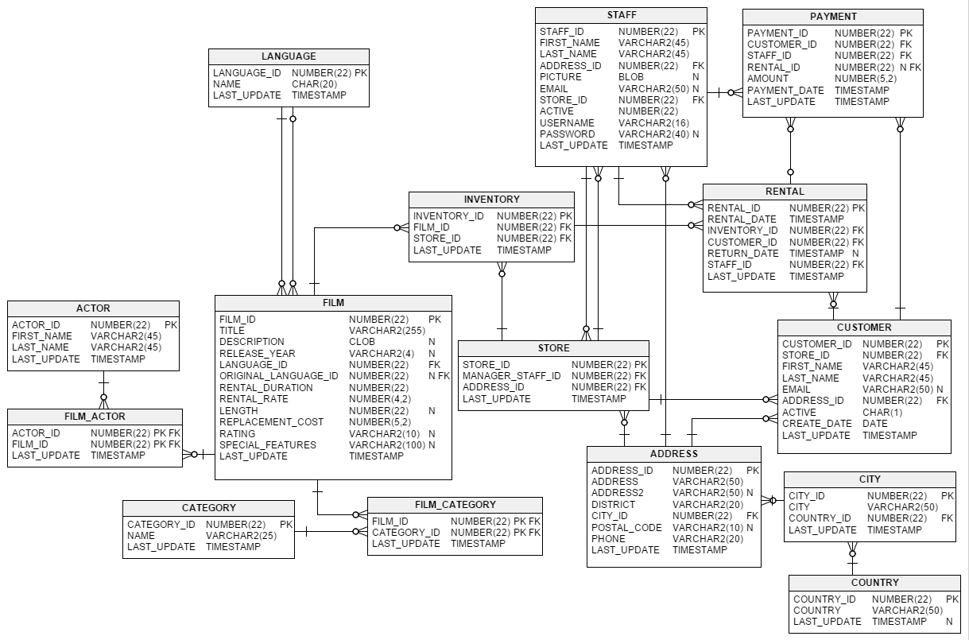
Database: Sakila Database

Slide 5


Primary goals
Improved business by stocking up inventory as per audience preference

Slide 6
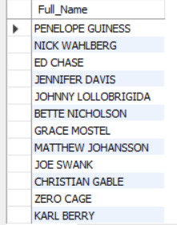
Full-Names of actors
Actor
Methods used
CONCAT: (first_name & last_name)
Tables used -
Output

Slide 7
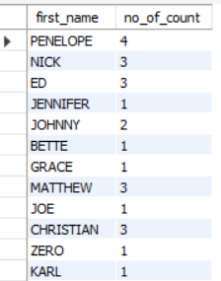
Number of times each first name appears
Actor
Methods used
COUNT: (first_name)
Tables used -
GROUP BY: first_name
AS: no_of_count
Output

Slide 8
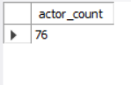
Unique first_name count
Actor
Methods used
COUNT (*) AS : Actor_count
Tables used -
SUBQUERY
GROUP BY : First_name
HAVING COUNT(*) : exactly equal to 1
Output

Slide 9
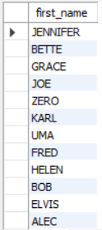
Unique first_name
Actor
Methods used
GROUP BY : First_name
Tables used -
HAVING COUNT(*) : exactly equal to 1
Output

Slide 10
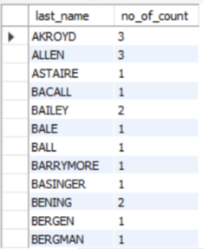
Number of time each last_name appears
Actor
Methods used
COUNT (last_name)
Tables used -
GROUP BY last_name
Output

Slide 11
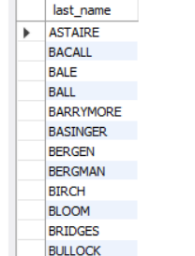
Unique Last Names
Actor
Methods used
GROUP BY last_name
Tables used -
HAVING COUNT(*) = 1
Output

Slide 12
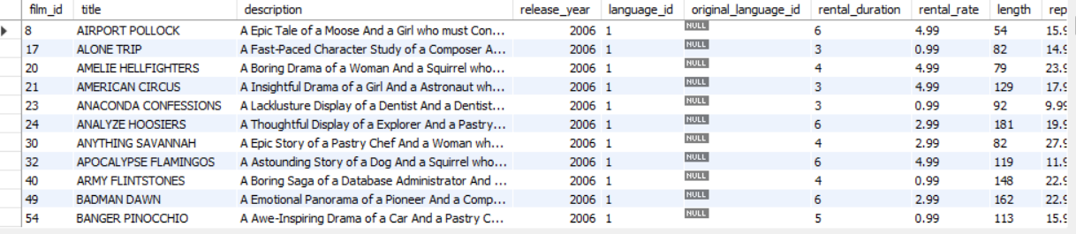
Movies with ‘R’ rating (17+ age movies)
film
Methods used
WHERE rating = ‘R’
Tables used -
Output

Slide 13
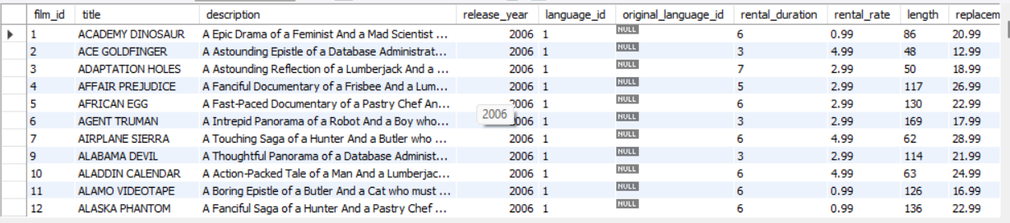
Movies other than ‘R’ rating
film
Methods used
WHERE rating != ‘R’
Tables used -
Output

Slide 14
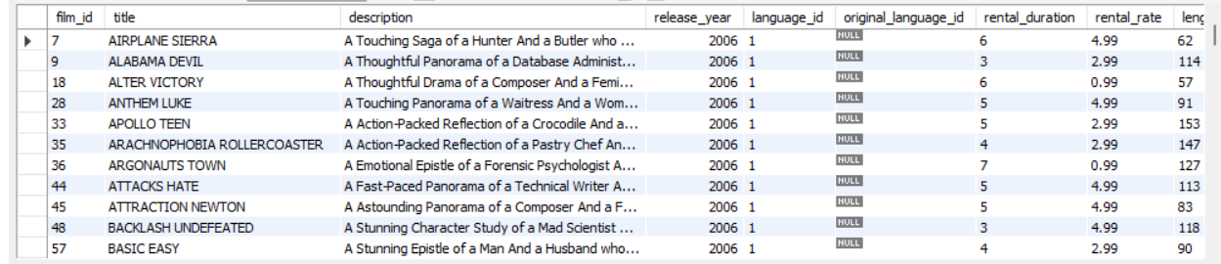
Suitable for audience below 13 years age
film
Methods used
WHERE rating = ‘PG-13’
Tables used -
Output

Slide 15
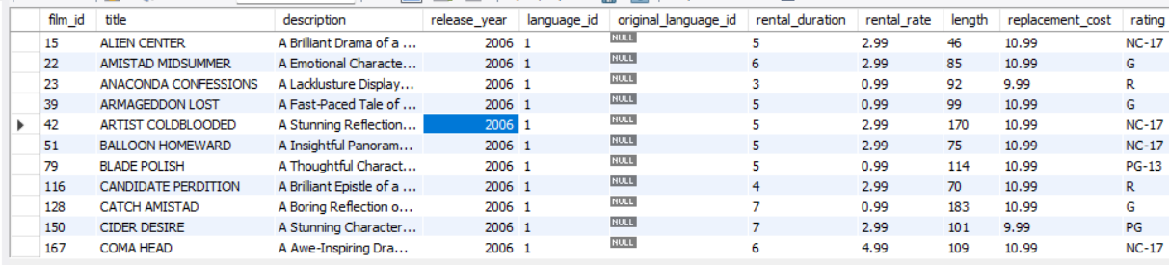
Movies with replacement_cost up to $11
film
Methods used
WHERE replacement_cost <= 11
Tables used -
Output

Slide 16
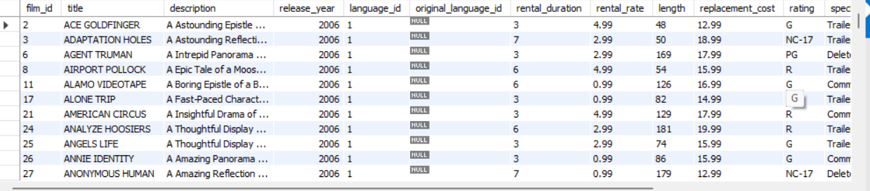
Movies with replacement_cost between $11 & $20
Film
Methods used
WHERE replacement_cost BETWEEN 11 AND 20
Tables used -
Output

Slide 17
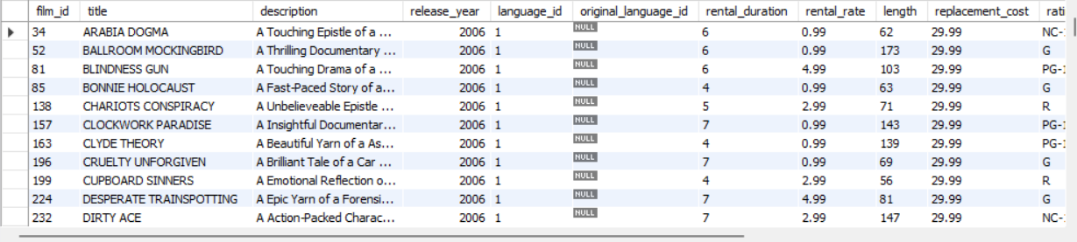
Movies with replacement_cost in desc order
film
Methods used
ORDER BY replacement_cost DESC
Tables used -
Output

Slide 18
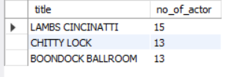
Top 3 movies with greatest number of actors
film
Methods used
COUNT (film_id) AS no_of_actor
Tables used -
Film_actor
INNER JOIN ON film.film_id=film_actor.film_id
GROUP BY title
ORDER BY no_of_actor DESC
LIMIT 3
Output

Slide 19
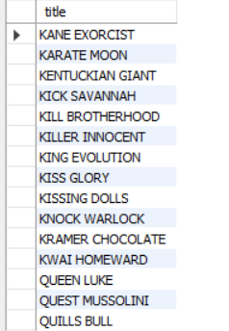
Movie title starting with letter ‘K’ or ‘Q’
film
Methods used
WHERE clause
Tables used -
LIKE ‘%K’ OR title LIKE ‘%Q’
Output

Slide 20
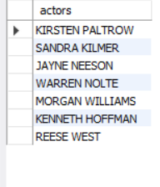
Names of actor who appeared in film ‘Agent Truman’
Film
Methods used
1st SUBQUERY - select film_id / WHERE title = ‘Agent Truman’
Tables used -
Film_actor
actor
2nd SUBQUERY - select actor_id / WHERE film_id in (1st SUBQUERY)
OUTER MOST QUERY - CONCAT (first & last name) AS actor / WHERE actor_id in (2nd SUBQUERY)
Output

Slide 21
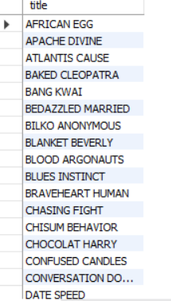
Movies categorized as family films
Film
Methods used
1st SUBQUERY - SELECT category_id / WHERE name = ‘Family’
Tables used -
Film_category
category
2nd SUBQUERY - SELECT film_id / WHERE category_id IN (1ST SUBQUERY)
OUTER MOST QUERY - SELECT title / WHERE film_id IN (2ND SUBQUERY)
Output

Slide 22
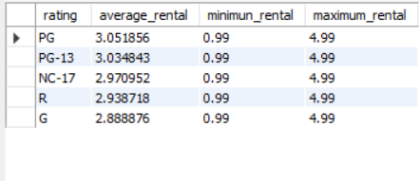
MAX,MIN,AVG rental_rates based on rating in desc order of avg rental_rates
film
Methods used
AVG , MIN , MAX
Tables used -
GROUP BY : rating
ORDER BY : average_rental
DESC
Output

Slide 23
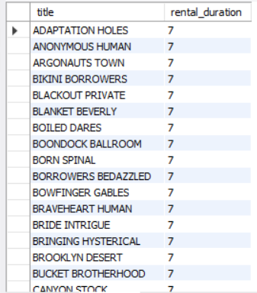
Rental frequency of movies in desc order
film
Methods used
ORDER BY
Tables used -
DESC
Output

Slide 24
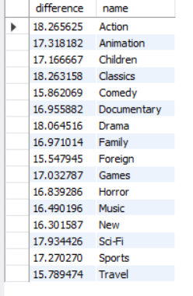
Film category where, diff b/w avg(replacement_cost) & avg(rental_rate) is greater than $15
Film
Methods used
AVG(REPLACEMENT_COST)-AVG(RENTAL RATES)
Tables used -
Film_category
Category
INNER JOIN on above 3 tables.
GROUP BY category
HAVING difference > 15
Output

Slide 25
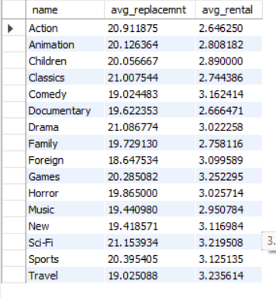
Category identified in previous task with AVG replacement_cost & rental_rates
Output
Film
Methods used
AVG
Tables used -
Film_category
category
INNER JOIN ON above 3 tables
GROUP BY name

Slide 26
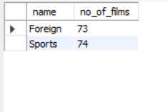
Film category with films greater than 70
Film
Methods used
INNER JOIN ON above 3 tables
Tables used -
Film_category
category
COUNT(title) AS no_of_films
HAVING COUNT(*)>70
Output

Slide 27

Areas of focus
Rental Frequency
Movies title
Movies with rental frequency of –
7, 6, 5, 4
Movies title starting with letter ‘K’ or ‘Q’

Slide 28


Summary
For the improved business management can follow these points -
1 - Movies title starting with 'K' or 'Q'.
2 - Movies with following actors –
'KIRSTEN PALTROW'
'SANDRA KILMER'
'JAYNE NEESON'
'WARREN NOLTE'
'MORGAN WILLIAMS'
'KENNETH HOFFMAN'
'REESE WEST’
3 - Movies with rental duration 7, 6, 5.
4- Movies belonging to foreign and sports category.

Slide 29




Thank you
Abhishek Sharma
as826385@gmail.com

